Slide 1

Chapter 5 Image Restoration and Reconstruction

Slide 2
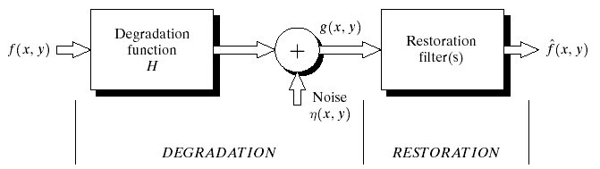
Digital Image Processing
5.1 A Model of the Image
Degradation/Restoration Process
FIGURE 5.1
A model of the image degradation/restoration process.
g(x,y)=h(x,y)*f(x,y)+η(x,y)
G(u,v)=H(u,v)F(u,v)+N(u,v)
(Linear/Additive model)

Slide 4
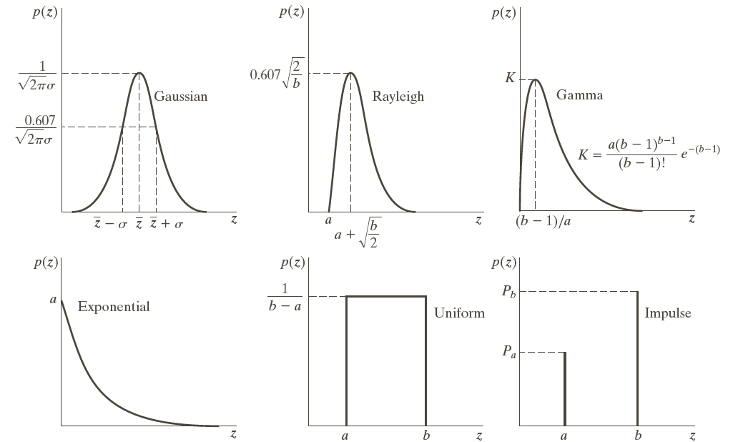
Digital Image Processing
5.2 Noise Models
FIGURE 5.2
Some important probability density functions.

Slide 5
Digital Image Processing
5.2 Noise Models
FIGURE 5.3
Test pattern used to illustrate the characteristics of the noise PDFs shown in Fig. 5.2
Test Pattern

Slide 6
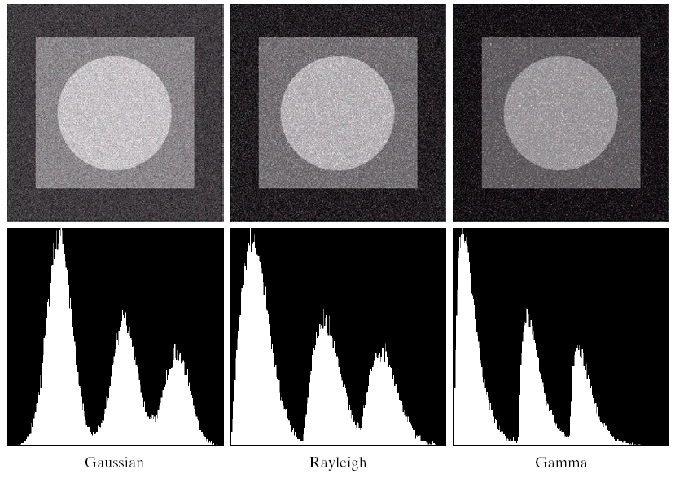
Digital Image Processing
5.2 Noise Models
Noisy images and their histograms
FIGURE 5.4
Images and histograms resulting from adding Gaussian, Rayleigh and gamma noise to the image in Fig. 5.3.

Slide 7
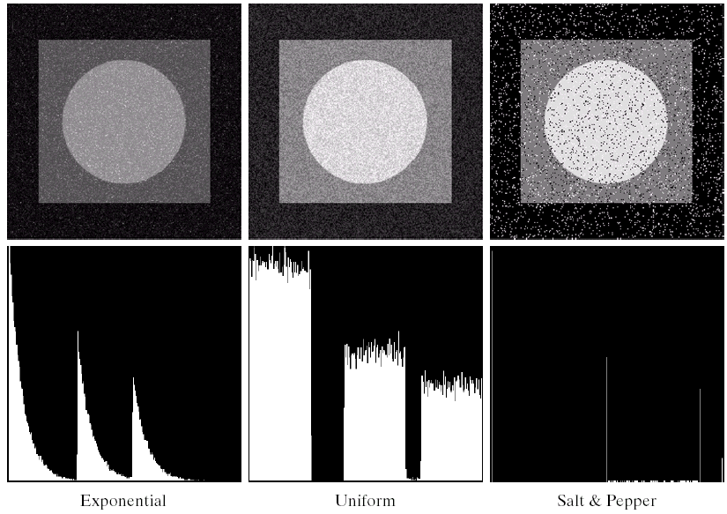
Digital Image Processing
5.2 Noise Models
FIGURE 5.4
(Continued) Images and histograms resulting from adding exponential, uniform, and impulse noised to the image in Fig. 5.3

Slide 8
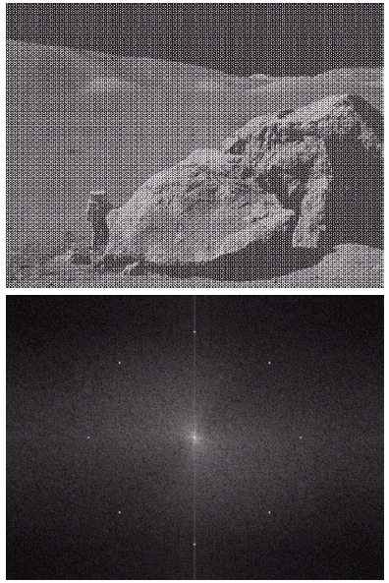
Digital Image Processing
5.2 Noise Models
Periodic Noise:
– Electronic Devices
FIGURE 5.5
Image corrupted by sinusoidal noise.
Spectrum (each pair of conjugate impulses corresponds to one sine wave).

Slide 10
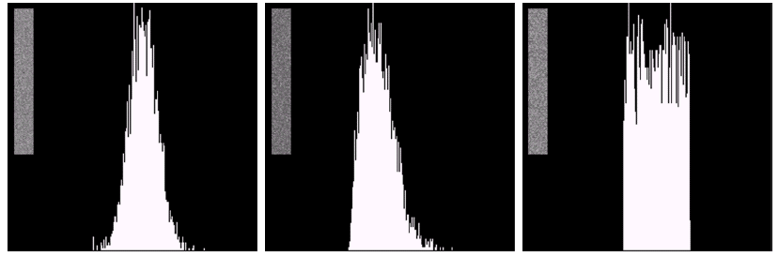
Digital Image Processing
5.2 Noise Models
Gaussian
Rayleigh
Uniform
FIGURE 5.6
Histograms computed using small strips from (a) the Gaussian, (b) the Rayleigh and (c) the uniform noisy images in Fig. 5.4

Slide 15
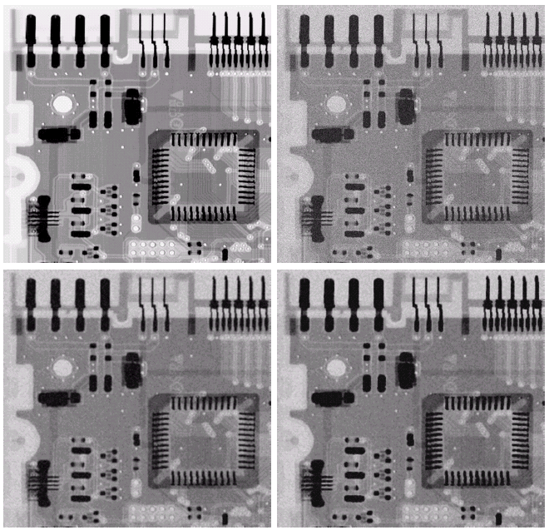
Digital Image Processing
5.3 Spatial Filtering
Original
X-ray Image
Gaussian Noise
Arithmetic Mean Filter
Geometric Mean Filter
More-Less
Blurring
FIGURE 5.7

Slide 16
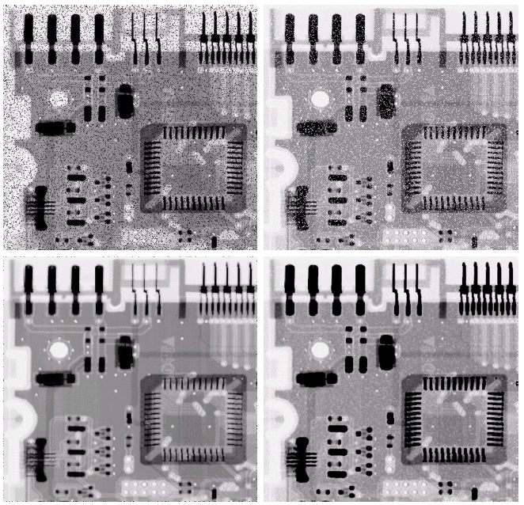
Digital Image Processing
5.3 Spatial Filtering
Pepper Noise
Salt Noise
Contraharmonic Filter Q = +1.5
Contraharmonic Filter Q = -1.5
Thin-Fat
Fingers
FIGURE 5.8

Slide 17
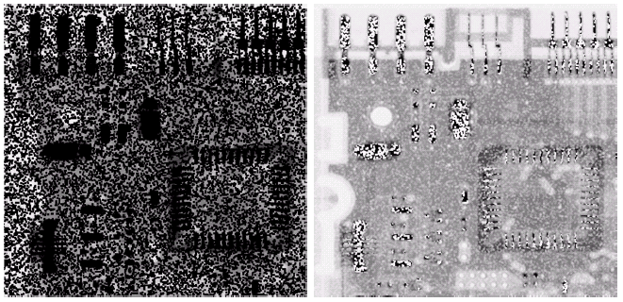
Digital Image Processing
5.3 Spatial Filtering
Wrong sign in contraharmonic filtering
Filtering pepper noise with Q = -1.5
Filtering salt noise with Q=+1.5
FIGURE 5.9

Slide 18
Order Statistic Filters:

Slide 19
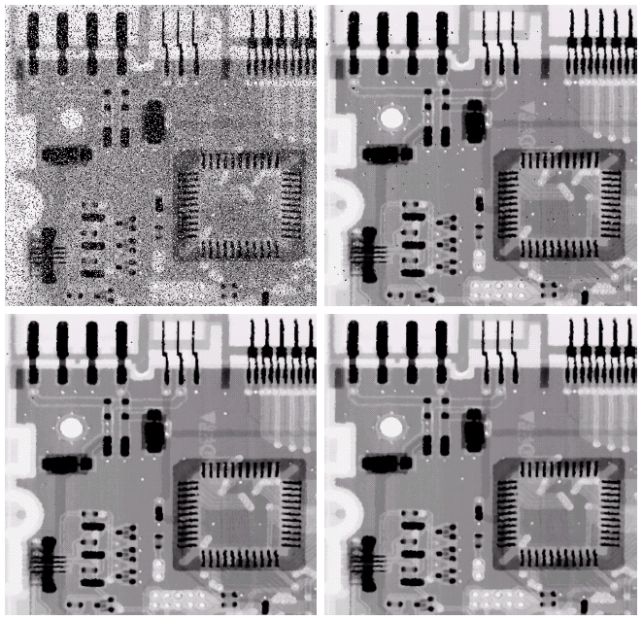
Digital Image Processing
5.3 Spatial Filtering
Salt-and-Pepper Noise
Median Filter
Median Filter twice
Median Filter three times
FIGURE 5.10

Slide 22
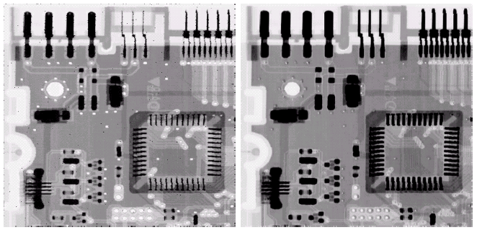
Digital Image Processing
5.3 Spatial Filtering
Max Filter
-Pepper Noise
Min Filter
-Salt Noise
FIGURE 5.11

Slide 23
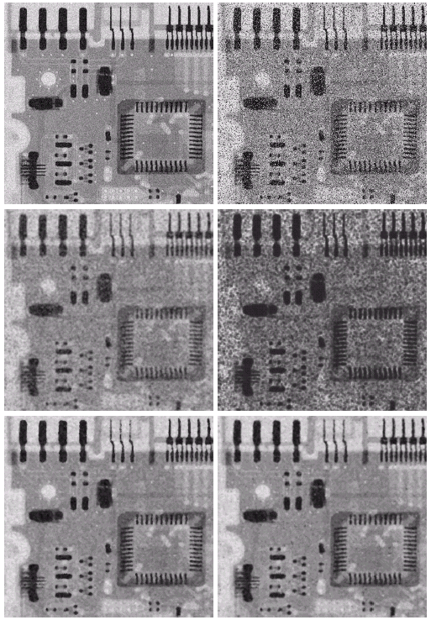
Digital Image Processing
5.3 Spatial Filtering
Additional
Salt-and-Pepper Noise
Uniform Noise
Arithmetic Mean Filter
Geometric Mean Filter
Alpha-trimmed Mean Filter
Median Filter
All 5×5
FIGURE 5.12

Slide 25
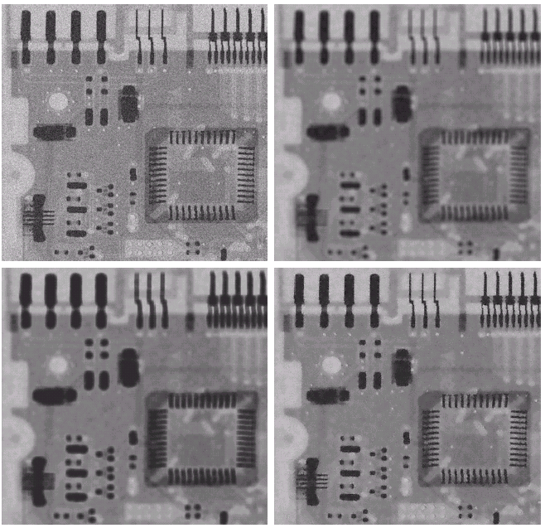
Digital Image Processing
5.3 Spatial Filtering
Arithmetic Mean Filter
Gaussian Noise
Geometric Mean Filter
Adaptive Noise Reduction Filter
FIGURE 5.13

Slide 27
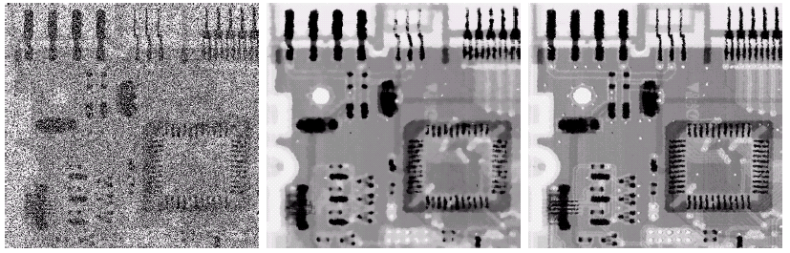
Digital Image Processing
5.3 Spatial Filtering
Salt-and-Pepper Noise
Adaptive Median Filter
Median Filter
FIGURE 5.14

Slide 29
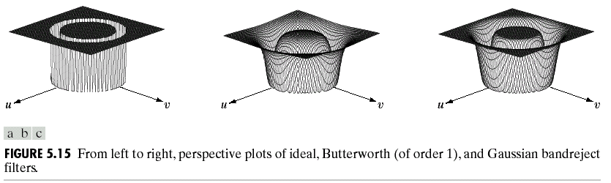
Digital Image Processing
5.4 Frequency Domain Filter
Bandreject Filters
Ideal
Butterworth(1)
Gaussian
FIGURE 5.15
Perspective plots of bandreject filters.

Slide 30
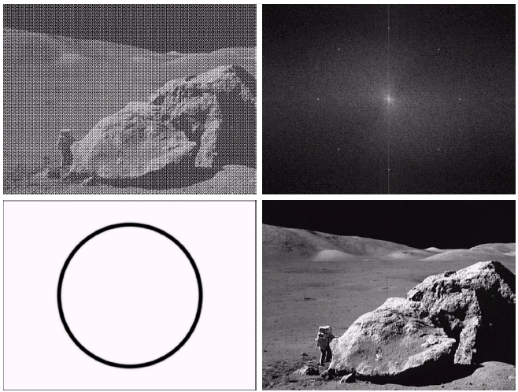
Digital Image Processing
5.4 Frequency Domain Filter
Sinusoidal Noise
Spectrum
Result of Filtering
Butterworth Filter
FIGURE 5.16

Slide 31
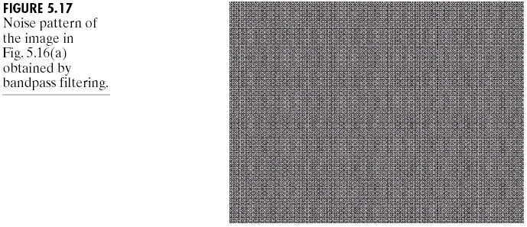
Digital Image Processing
5.4 Frequency Domain Filter
Band Pass Filter (Extract Periodic Noises)
Noise pattern obtained by bandpass filtering.
FIGURE 5.17

Slide 33
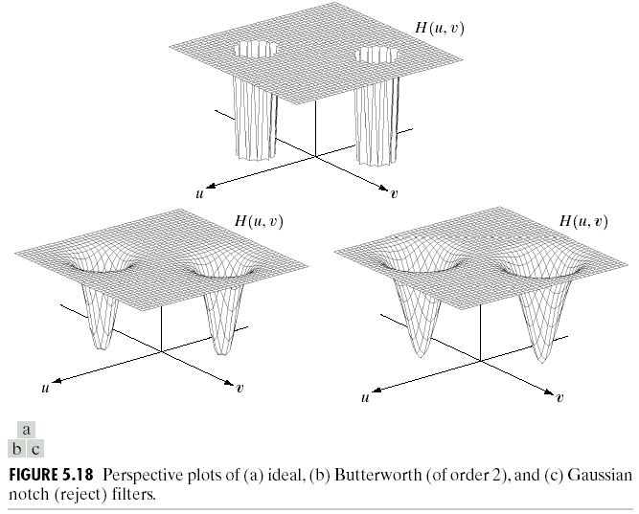
Digital Image Processing
5.4 Frequency Domain Filter
Notch Filters
Ideal
Butterworth
Gaussian
FIGURE 5.18
Perspective plots of notch (reject) filters.

Slide 34
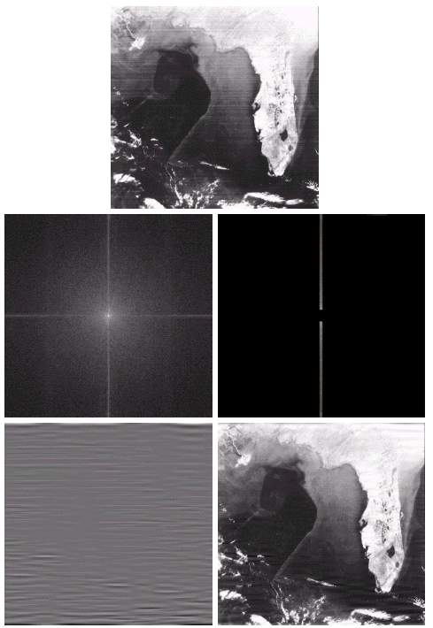
Digital Image Processing
5.4 Frequency Domain Filter
FIGURE 5.19
Notch Pass Filter
Spectrum
Noise Pattern in
Spatial Domain
Result of Filtering

Slide 35
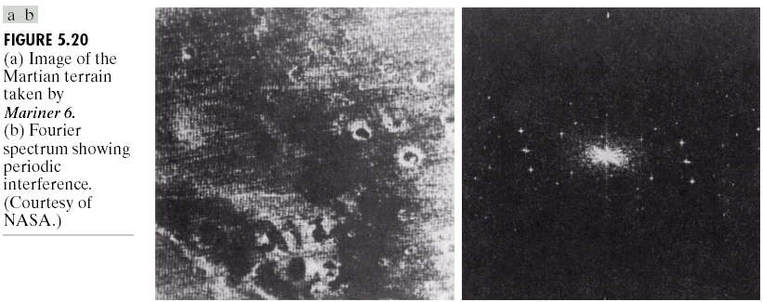
Digital Image Processing
5.4 Frequency Domain Filter
Periodic Inference Shown in Fourier Spectrum
FIGURE 5.20

Slide 39
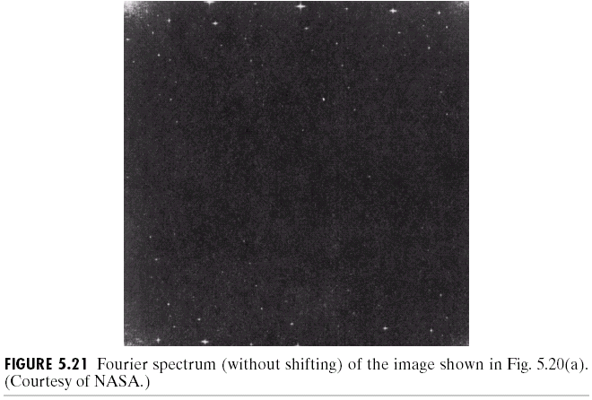
Digital Image Processing
5.4 Frequency Domain Filter
Fourier Spectrum of Corrupted Image (without shifting)
FIGURE 5.21

Slide 40
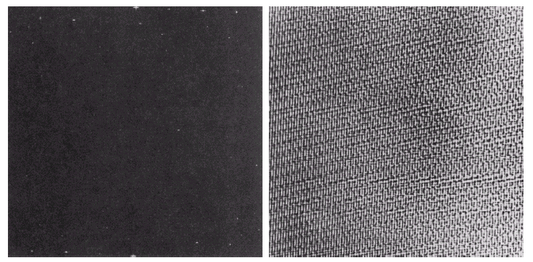
Digital Image Processing
5.4 Frequency Domain Filter
Spectrum of noise
Interference pattern
N(u,v)=H(u,v)G(u,v) η(x,y)=ℑ ⁻¹{H(u,v)G(u,v)}
FIGURE 5.22

Slide 41
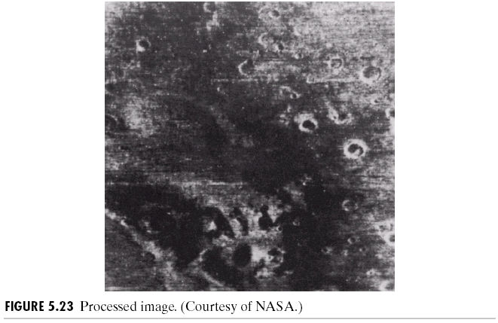
Digital Image Processing
5.4 Frequency Domain Filter
Filtered Image
FIGURE 5.23

Slide 44
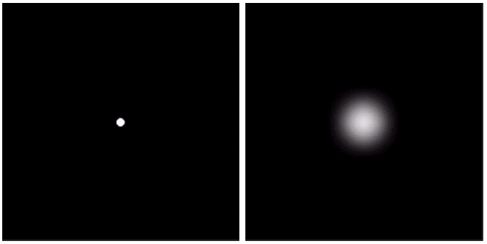
Digital Image Processing
5.6 Estimating the Degradation
Function
Light Impulse
Degraded Impulse
FIGURE 5.24
Degradation Estimation Example

Slide 46
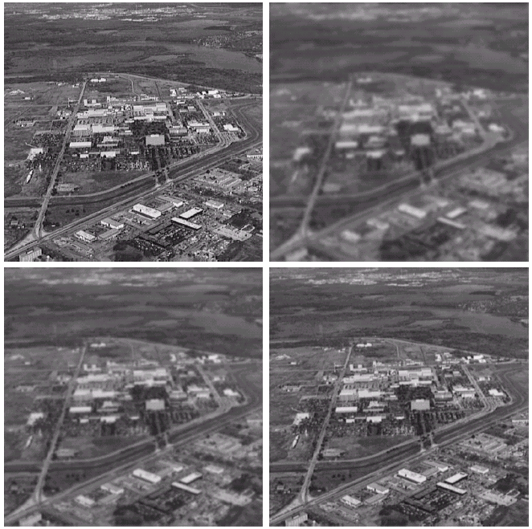
Digital Image Processing
5.6 Estimating the Degradation
Function
Modeling of turbulence in atmospheric images
Negligible Turbulence
k = 0.0025
k = 0.001
k = 0.00025
FIGURE 5.25

Slide 50
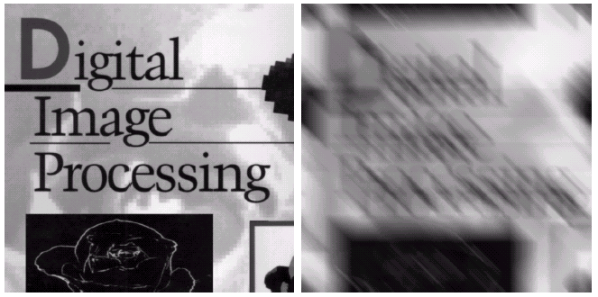
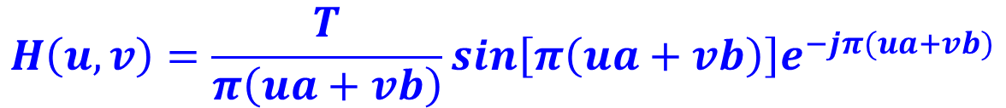
Digital Image Processing
5.6 Estimating the Degradation
Function
$$H\left(u,v\right)=\frac{T}{π\left(ua+vb\right)}sin\left[π\left(ua+vb\right)\right]e^{−jπ(ua+vb)}$$
Original Image
Result of Blurring
FIGURE 5.26

Slide 53
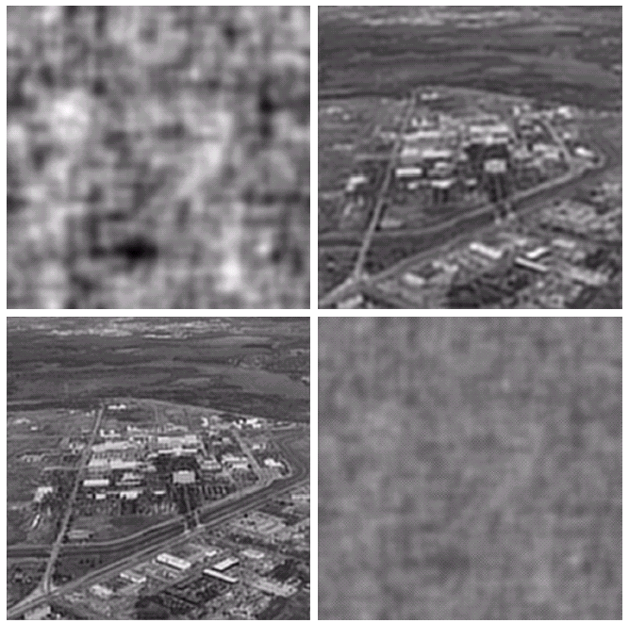
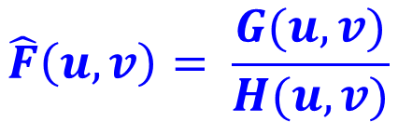
Digital Image Processing
5.7 Inverse Filtering
Full Filter
Radius 60
$$\hat{F}\left(u,v\right)= \frac{G(u,v)}{H(u,v)}$$
Radius 70
Radius 85
FIGURE 5.27

Slide 63
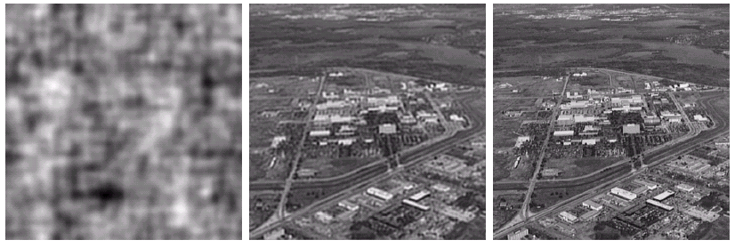
Digital Image Processing
5.8 Minimum Mean Square Error (Wiener) Filtering
Full Inverse
Filter
Radially Limited Inverse Filter
Wiener Filter
FIGURE 5.28
Filtering of Fig. 5.25

Slide 64
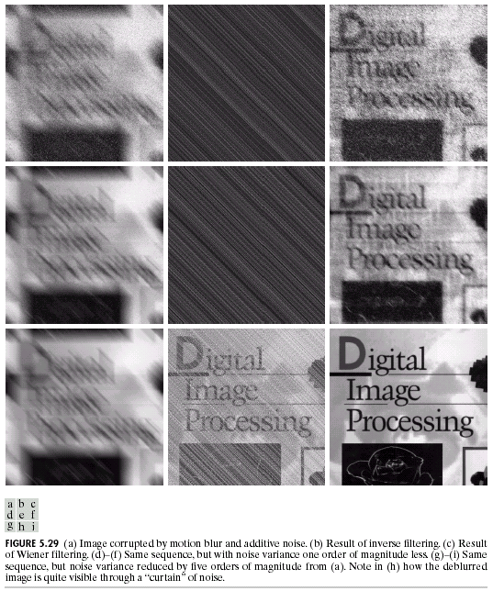
Digital Image Processing
5.8 Minimum Mean Square Error (Wiener) Filtering
FIGURE 5.29
Motion Blur and Noise
Inverse Filter
Wiener Filter
One order of magnitude less noise
Five order of magnitude less noise

Slide 65
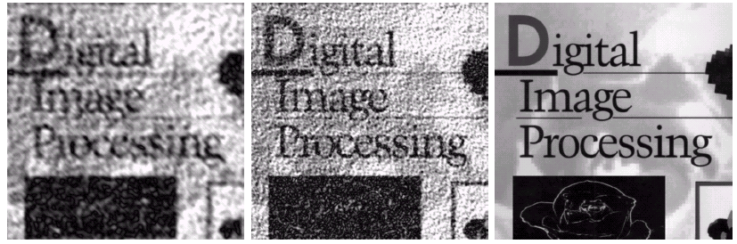
Digital Image Processing
5.9 Constrained Least Squares Filtering
High Noise
Mid Noise
Low Noise
FIGURE 5.30

Slide 66
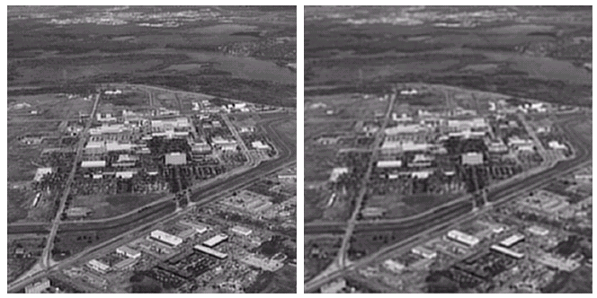
Digital Image Processing
5.9 Constrained Least Squares Filtering
Correct Noise Parameter
Wrong Noise Parameter
FIGURE 5.31

Slide 67
Digital Image Processing
5.11 Image Reconstruction
from Projections
A single object on a uniform background
FIGURE 5.32

Slide 68
Digital Image Processing
5.11 Image Reconstruction
from Projections
Reconstruction using 1, 2, 3, 4, 32 back projections
FIGURE 5.33

Slide 69
Digital Image Processing
5.11 Image Reconstruction
from Projections
Reconstruction two objects using
1, 2, 4, 32, 64 back projections
FIGURE 5.34

Slide 70
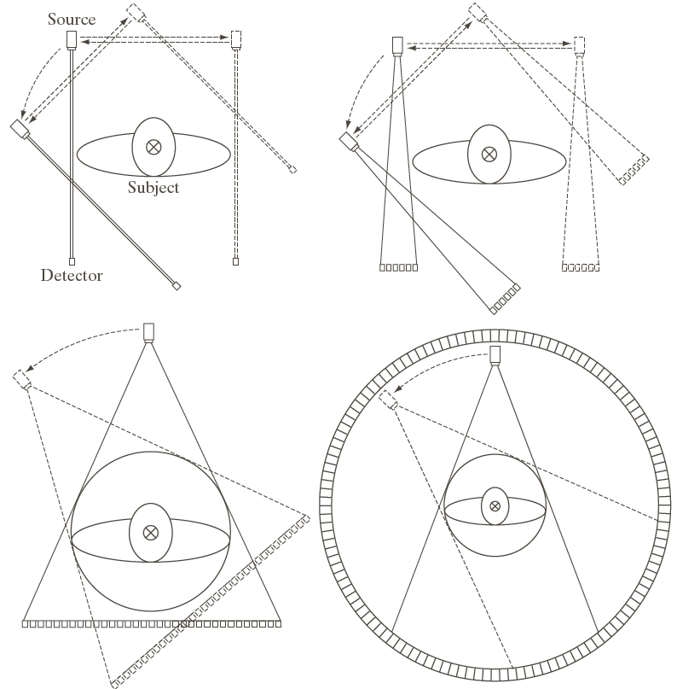
Digital Image Processing
5.11 Image Reconstruction
from Projections
Four generations of CT scanner
Dotted Arrow Lines: Linear Motion
Dotted Arrow Arcs: Incremental Rotation
Cross-mark: Perpendicular Linear Motion

Slide 71
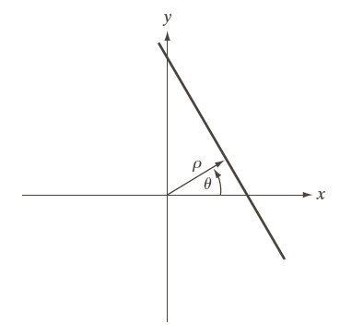
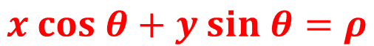
Digital Image Processing
5.11 Image Reconstruction
from Projections
Normal representation of a straight line
$$x cos θ+y sin θ=ρ$$
FIGURE 5.36

Slide 72
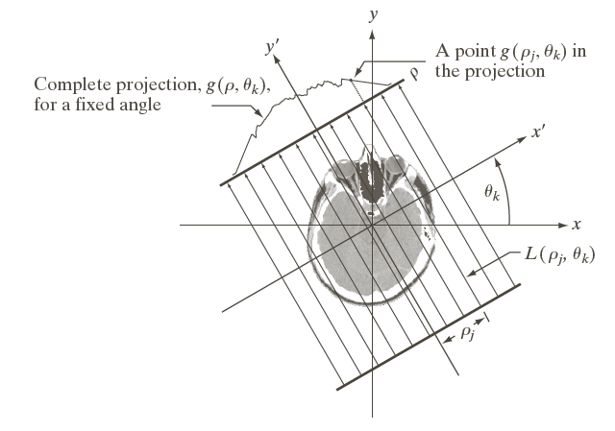
Digital Image Processing
5.11 Image Reconstruction
from Projections
Geometry of a parallel-ray beam
FIGURE 5.37

Slide 73
Digital Image Processing
5.11 Image Reconstruction
from Projections
A disk and a plot of its Radon transform, derived analytically
FIGURE 5.38

Slide 74
Digital Image Processing
5.11 Image Reconstruction
from Projections
Two images and their sonograms (Radon transforms)
Shepp-Logan phantom
FIGURE 5.39

Slide 75
Digital Image Processing
5.11 Image Reconstruction
from Projections
Back Projections
FIGURE 5.40
Back projections of the sonograms in Fig. 5.39.

Slide 76
Digital Image Processing
5.11 Image Reconstruction
from Projections
The 1-D Fourier transform of a projection is a slice of the 2-D Fourier transform.
FIGURE 5.41 Illustration of the Fourier-slice theorem.

Slide 77
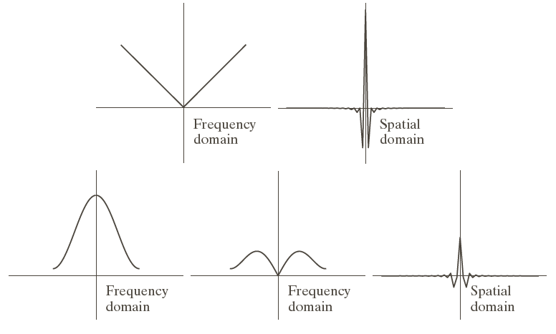
Digital Image Processing
5.11 Image Reconstruction
from Projections
FIGURE 5.42
Hamming-windowed ramp filter.
Band-limited Filter
Hamming Windowing Function
Windowed Ramp Filter

Slide 78
Digital Image Processing
5.11 Image Reconstruction
from Projections
Hamming-windowed Ramp Filter
Ramp Filter
FIGURE 5.43 Filtered back projections of rectangle.

Slide 79
Digital Image Processing
5.11 Image Reconstruction
from Projections
Hamming-windowed Ramp Filter
Ramp Filter
FIGURE 5.44 Filtered back projections of the head phantom.

Slide 80
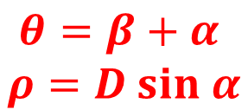
Digital Image Processing
5.11 Image Reconstruction
from Projections
Basic Fan-Beam Geometry
$$θ=β+α$$
$$ρ=D sin α$$
FIGURE 5.45

Slide 81
Digital Image Processing
5.11 Image Reconstruction
from Projections
Maximum value of α needed to encompass a region of interest
FIGURE 5.46

Slide 82

Digital Image Processing
5.11 Image Reconstruction
from Projections
Polar representation of an arbitrary point on a ray of a fan-beam
$$r cos\left(β +α −φ\right)−D sin α$$
$$=R sin(α^{′}−α)$$
FIGURE 5.47

Slide 83
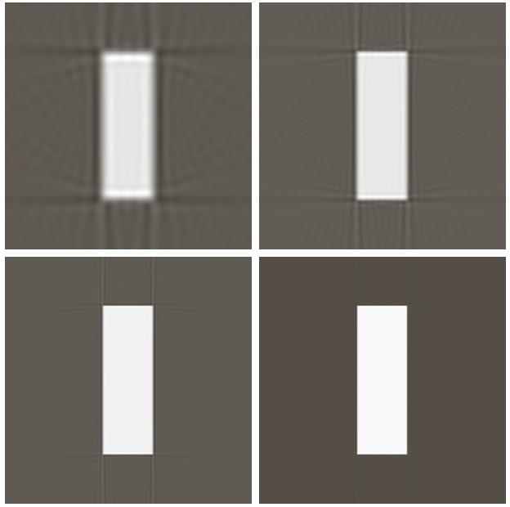
Digital Image Processing
5.11 Image Reconstruction
from Projections
Reconstruction of the rectangle
1°increments
0.25°increments
0.5°increments
0.125°increments
FIGURE 5.48

Slide 84
Digital Image Processing
5.11 Image Reconstruction
from Projections
Reconstruction of the head phantom
1°increments
0.25°increments
0.5°increments
0.125°increments
FIGURE 5.49

Slide 85
Geometric Operations-Chapter 8 of Castleman DIP
8.1 Introduction
Two separate algorithms are required for a geometric operation.
1). Spatial transformation which specifies the “motion” of each pixel as it “moves” from its initial to its final position in the image.
2). Gray-level interpolation.

Slide 86






Examples
Lenna and its transformed images

Slide 87
8.1.1 The Spatial Transformation
The spatial transformation defines the spatial relationship between points in the input image and points in the output image.
Where is the input image and is the output image. The functions and specify the spatial transformation.

Slide 88
8.1.2 Gray-Level Interpolation
Gray-level interpolation is necessary because the gray-level values are defined only at integral values of x and y, however, spatial transformation may make the output image taking values at fractional positions of and .

Slide 89
Pixel Carry-Over (Forward-Mapping) Interpolation
If an input pixel maps to a position between four output pixels, then its gray level is divided among the four output pixels according to the interpolation rule.

Slide 90
Pixel Filling (Backward-Mapping) Interpolation
If an output pixel falls between four input pixels, its gray level is determined by the four input pixels according to the interpolation rule.

Slide 91
Pixel-filling Interpolation
8.2.1 Nearest Interpolation (zero-order)
The gray level of the output pixel is taken to be that of the input pixel nearest the location to which the output pixel maps.
Characteristics of the nearest neighbor interpolation
Computationally simple
Sometimes produce artifacts

Slide 92
8.2.2 Bilinear Interpolation (first-order)
For a function of two variables, given its values at four vertices of the unit square , , and , we desire to determine the value of at an arbitrary point inside the square. This can be done by a hyperbolic paraboloid defined by the bilinear equation

Slide 93
The four coefficients a,b,c,d can be determined by solving four linear equations.

Slide 94
Another way to determine coefficients
First linearly interpolate between the upper two points and
Second, interpolate between the two lower points and

Slide 95
Finally, linearly interpolate vertically
Substituting the first two equations into the third produces
This agrees with the result of the first method.

Slide 96
Bilinear Interpolation

Slide 97
An example
Suppose f(0,0)=2,f(1,0)=3,f(0,1)=1,f(1,1)=4
Then f(x,y)=x-y+2xy+2

Slide 98
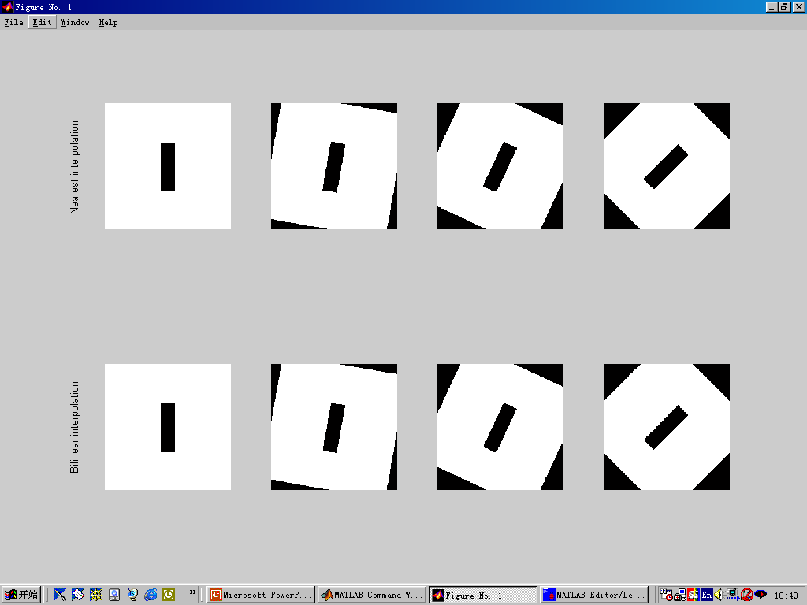
Comparison of Nearest and Bilinear Interpolations

Slide 99

Another example
An image of tiger

Slide 100
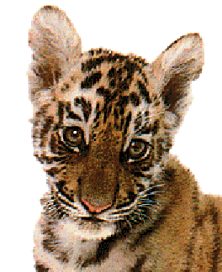
Enalrged image by 1.5× (Complex texture,visually no difference)
Nearest Neighbor interpolation
Bilinear interpolation

Slide 101
Higher Order Interpolation
The smoothing effect of bilinear interpolation may degrade fine details in the image and sometimes the slope discontinuities of bilinear interpolation may produce undesirable effects.
When the number of points exceeds that of coefficients, a curve-fitting or error-minimizing procedure can be used.
Examples of higher order interpolation: Bicubic; Cubic splines; Legendre centered functions, function , et.al. .

Slide 102
8.3 The Spatial Transformation
8.3.1 Simple Transformations
Translation
Can be expressed in homogeneous coordinates as

Slide 103
Scaling
Homogeneous form
When : reflection about the y-axis

Slide 104
Rotation about the origin

Slide 105
Rotation about the point

Slide 107
Separable Implementation
Translation and scaling is naturally separable, that can be implemented separately for x-axis and y-axis.
Separable implementation of Rotation
Step 1:
Step 2:

Slide 108
8.3.2 General Transformation
For relatively complex spatial transformations, usually no analytic expression exists, in these situations, the pixel position relationship is obtained from measurement of actual images.
Such an example is the geometric calibration of an image taken with a camera having geometric distortion.

Slide 109
Specification by Control Points
Specifying the spatial transformation as a series of displacement values for selected control points in the image.
A polynomial is commonly used as the general form of the transformation expression.
Polynomial of up to the fifth order is practical.

Slide 110
Polynomial Warping
When the number of terms in the polynomial matches the number of control points, solve simultaneous linear equations.
When there are more control points, use a fitting procedure.
Pseudoinverse matrix; Singular value decomposition;

Slide 111
8.3 The Spatial Transformation
Control Points and Polynomial Warping
Break the image into polygonal regions or quadrilaterals and use piecewise bilinear mapping functions or polynomials.
Input
Output

Slide 112
8.3 The Spatial Transformation
Control Grid Interpolation
Bilinear spatial transformation
The eight coefficients can be determined by four pairs of vertices of corresponding grids between the input and output images.
A more efficient way to implement bilinear transformation

Slide 113
8.4 Applications of Geometric Operations
Geometric Calibration
Removal of camera-induced geometric distortion of images, such as those from satellites and radar.
Image Rectification
Images taken by imaging systems using non-rectangular pixel coordinates must be rectified before processing or display

Slide 114
8.4 Applications of Geometric Operations
Rectification of images digitized by angle-scanning camera involves the projection of a spherical surface onto a tangent plane.
A fifth-order polynomial warp, implemented in a polar coordinate system, can rectify images taken by a fish-eye wide-angle camera.

Slide 115
8.4 Applications of Geometric Operations
Image Registration
Registering similar images before comparison.
Image Format Conversion
Image Format Conversion
Making images of chromosomes straight by properly designed geometric transformation with control grid techniques.

Slide 116
8.4 Applications of Geometric Operations
Map Projection
Geometric transformations are used to project spherical surface to map in a plane.
Morphing（变形）
Morphing is a technique that allows one object to transform gradually into another, which can produce more realistic looking transformation in image fades out and fades in.

Slide 117
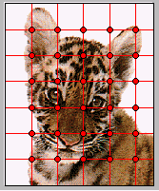
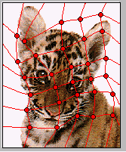
Spatial Transformation

Slide 118
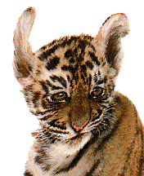
Spatial Transformation

Slide 119
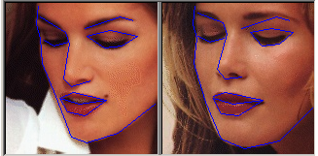


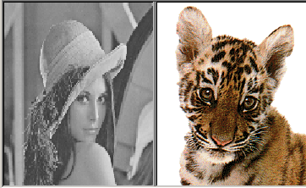
Morphing
http://www.morpheussoftware.net/

Slide 120
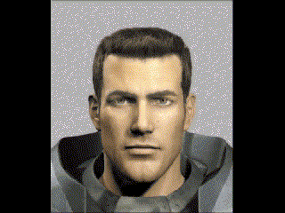

Morphing

Slide 121

